Slide 1
WDI 10 PROJECT 1 IDEA
Dance Dance Revolution

Slide 2
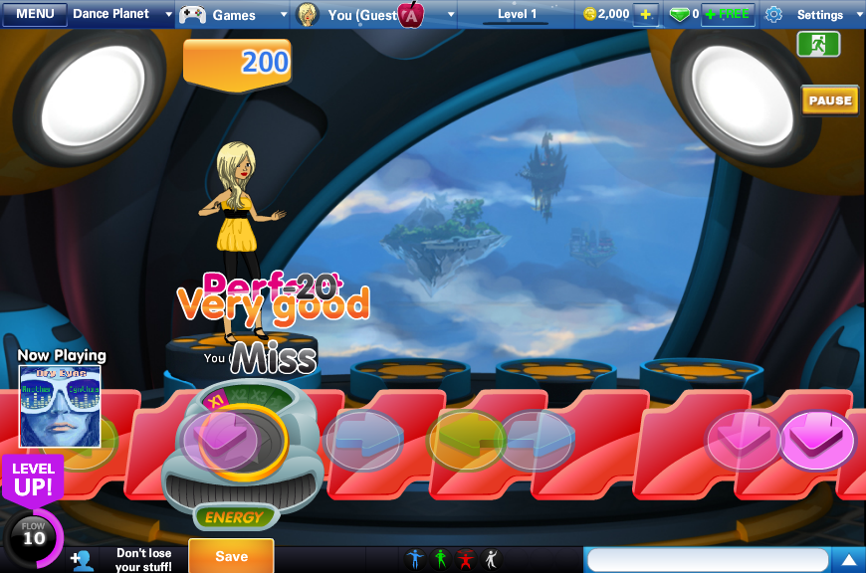
Players hit coloured arrows following the pattern of musical and visual cues

Slide 3
Can match the moving tiles with the target when keys are down
Tiles move according to the beat
Scoring system
Basic features
Basic features
Juice!
0
SCORE :
100
Some more features

Slide 4
Comments on player’s performance
Excellent
Very good
Good
Bad
Different sound effects for different comments
Visual effects when keys are down
Basic features
Juice!
Juice!
Some more features

Slide 5
Basic features
Menu page
Player can choose the song
Two player game
Different player using different keys to play on the same keyboard
Juice!
Some more features
Some more features

Slide 6
THANK YOU
THANK YOU

